Slide 1

Getting Started with Omega 2+
Module
Anant Kaushik

Slide 2
Contents
Title | Page
Omega 2+ | 3
Omega 2+ Specs | 5
Pins of Omega 2+ | 6
Expansion Dock | 7
The Expansion Header | 9
Getting the Hardware Ready | 10
Provide Power | 11
Using the Setup Wizard | 12
Connect to the Omega’s WiFi Network | 13
The Setup Wizard | 14
Login | 15
Configure Wi-Fi | 16
Cloud | 17
Install Console | 18
Setup Done | 19

Slide 3
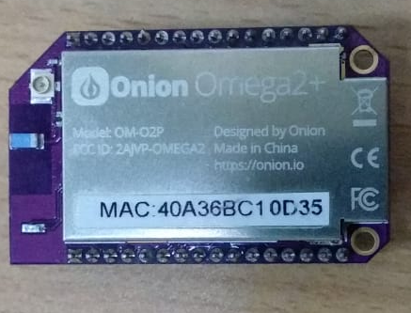
Omega 2+
It is a Linux computer designed specifically for building connected hardware applications. It combines the tiny form factor and power-efficiency of the Arduino, with the power and flexibilities of the Raspberry Pi. The Omega2+ is simple, even for people who are just getting started with building hardware. The Omega2+ has integrated Wi-Fi and on-board flash storage.

Slide 4
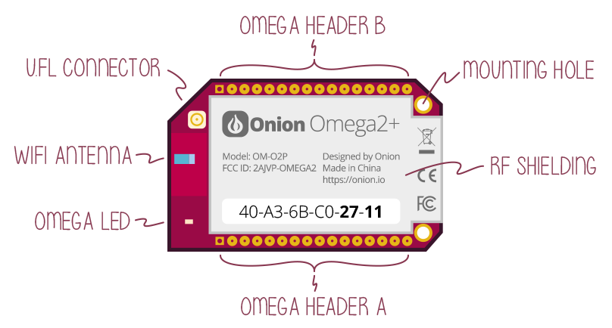
Omega 2+

Slide 5
Omega 2+ Specs
Omega 2+ Specs
Processor | 580MHz MIPS CPU
Memory | 128MB Memory
Storage | 32MB Storage
USB | USB 2.0
MicroSD Slot | Yes
WiFi adapter | b/g/n Wi-Fi
GPIOs | 18
PWM | 2
UART | 2
I2C | 1
SPI | 1
I2S | 1

Slide 6
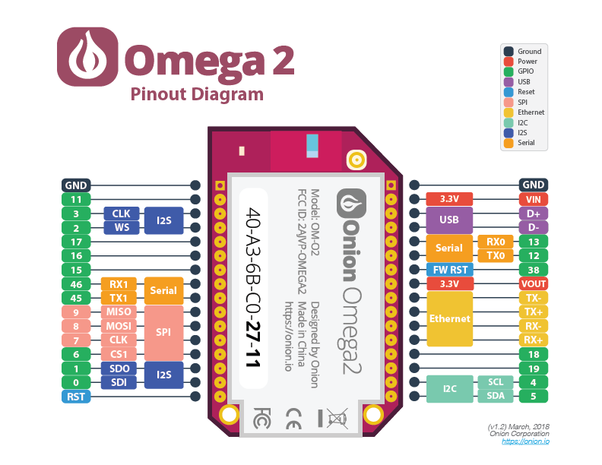
Pins of Omega 2+

Slide 7
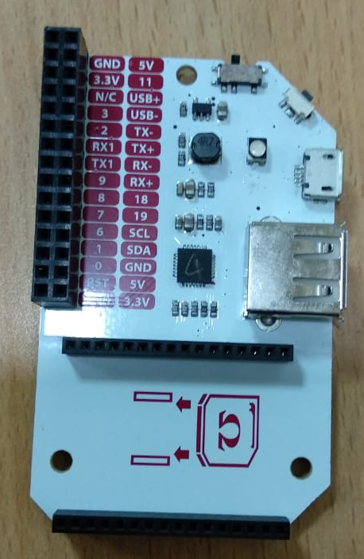
Expansion Dock
The Expansion dock is a powerful piece of hardware that simplifies the usage of your Omega. It allows you to power the Omega and communicate with it via serial through the Micro-USB port, and makes it incredibly easy to use the GPIOs and Onion Expansions.

Slide 8
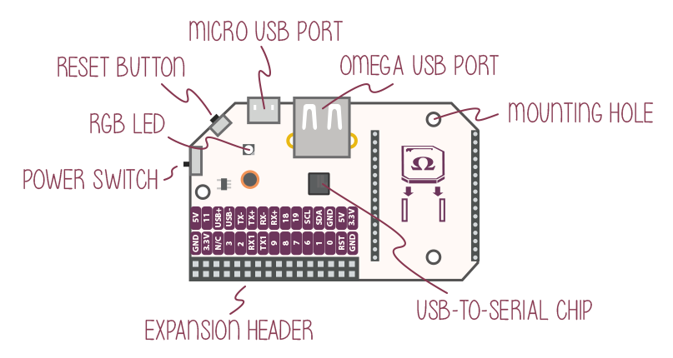
Expansion Dock

Slide 9
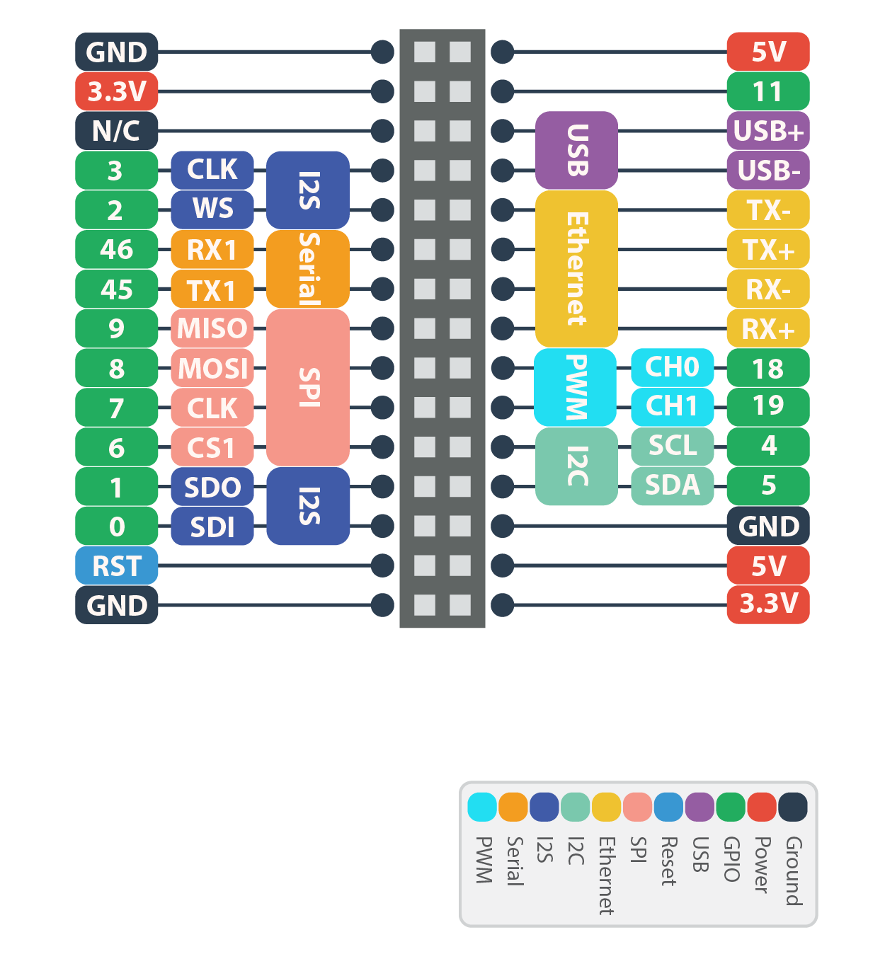
The Expansion Header

Slide 10
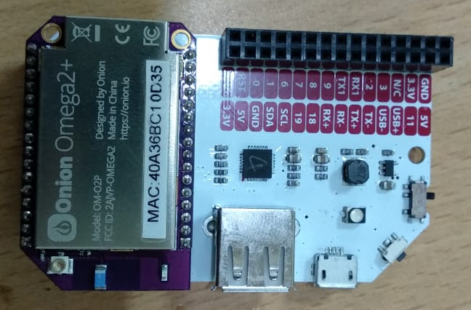
Getting the Hardware Ready
Plug the Omega into the socket on the Dock.
Make sure your Omega’s pins are fully plugged into the socket.

Slide 11
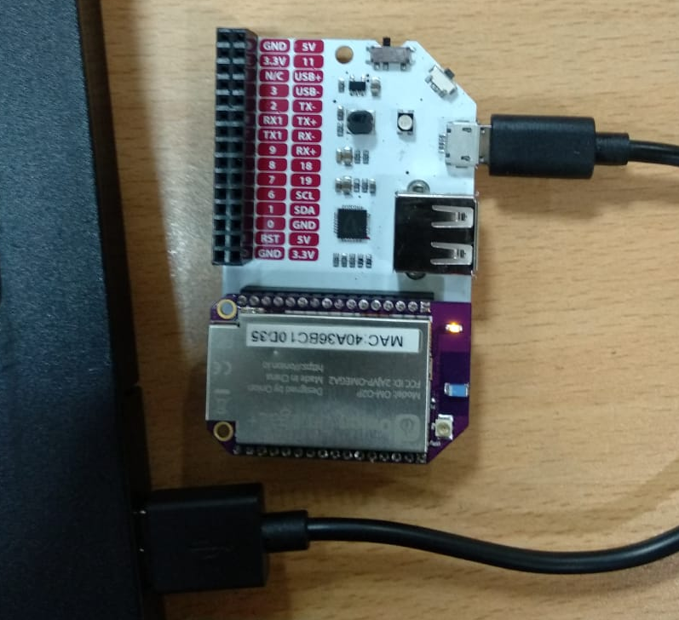
Provide Power
The Omega itself is powered by a 3.3V source. But all Omega Docks have voltage regulators so you can use any microUSB to power the Dock and Omega. You can power it with your computer
Wait till it boots

Slide 12
Using the Setup Wizard
Let’s find your Omega’s name before going any further. There’s a sticker on the Omega’s shielding:
The text printed here is the Omega’s unique MAC address, we’re interested in the last four digits that are in bold. Your Omega’s name is Omega-ABCD where ABCD are the last four digits from the sticker.
So the Omega from the picture above is named Omega-0D35.

Slide 13
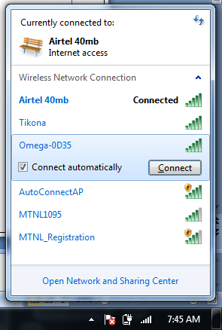
Connect to the Omega’s WiFi Network
The Omega hosts it’s own WiFi network access point. Lets connect your computer to it. The WiFi network is named the same as your Omega and the default password is 12345678.

Slide 14
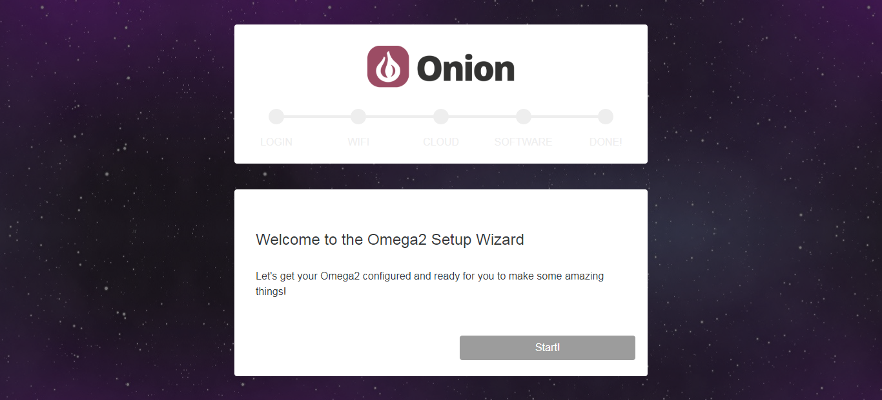
The Setup Wizard
Open your favourite browser and navigate to http://omega-ABCD.local/ where ABCD are the same characters from the network name above. If the page doesn’t load, you can also browse to http://192.168.3.1
You have now arrived at the Setup Wizard:

Slide 15
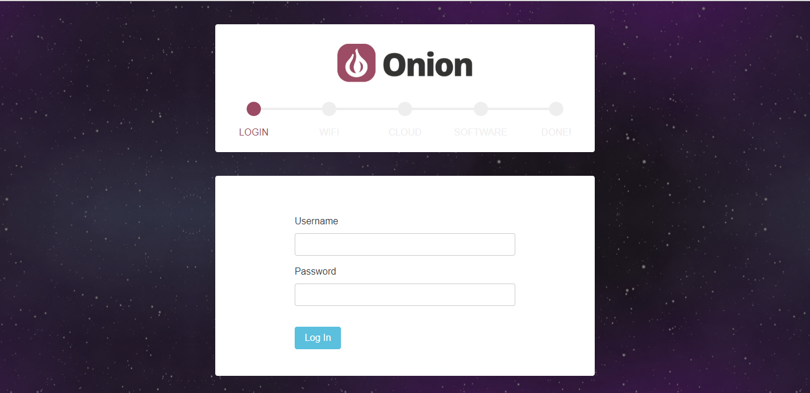
Login
Login with the Omega’s default credentials:
username: root
password: onioneer

Slide 16
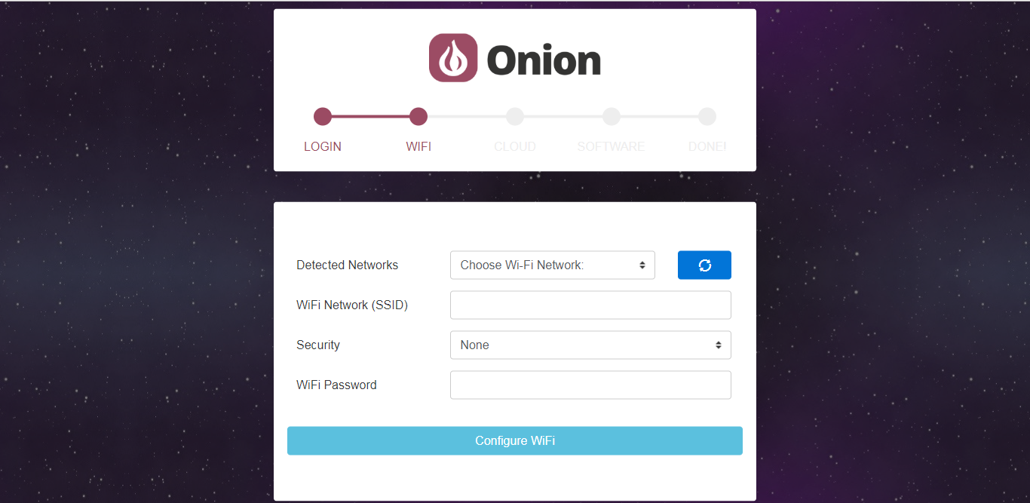
Configure Wi-Fi
After you’ve logged in you’ll be asked to connect to a Wireless Network.
Enter your Wireless Network information and click Configure. Your Omega will attempt to connect to the network. This can take up to a minute to complete.
The Omega’s AP will go down and not be accessible during this process, sit tight, it’ll come back up when the configuration is done!

Slide 17
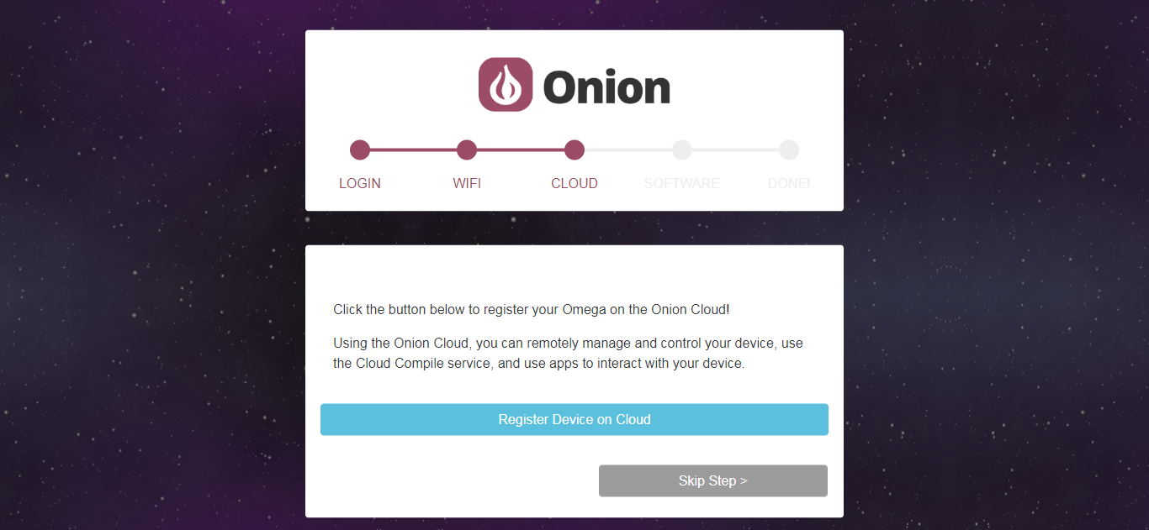
Cloud
On this step you can choose to register your device on the cloud. If you would like to do this some other time you can click Skip Step to move onto the next step.

Slide 18
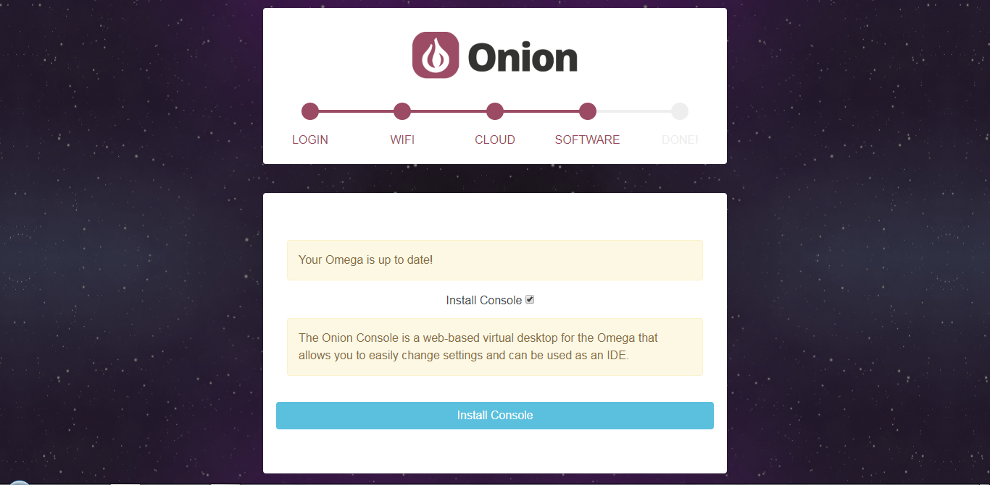
Install Console
Click the Install Console button to do just that. This will install the Console for you.
If you don’t want to install the Console you can de-select the checkbox above. You can always come back to the setup wizard to install the console afterwards.

Slide 19
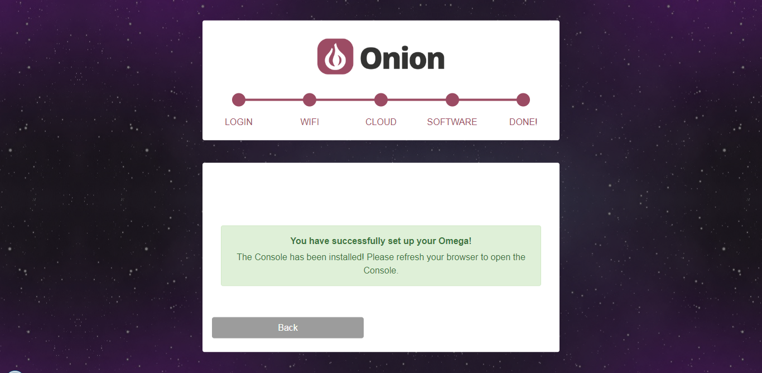
Setup Done
At the end of the installation process, the Omega will automatically reboot. It will be ready for use when the Omega’s LED stops flashing and remains solid.

Slide 20
Thank You !
Contact US
Nitin Sinha
nitin.sinha@goSigmaWay.com
+1 727-394-4375
+91 7838188809
Debjani Mitra
debjani.mitra@goSigmaWay.com
+1 952-583-3449
+91 9339555636
Anant Kaushik
anant.kaushik2@gmail.com
+91 8791262398

